Slide 1
STATIC STRUCTURAL SIMULATION
MESH CONVERGANCE ANALYSIS OF A HEXAGONAL BEAM
USING ANSYS WORKBENCH

Slide 2
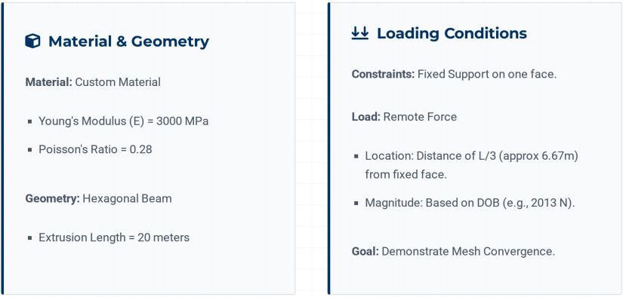
SIMULATION OBJECTIVE

Slide 3
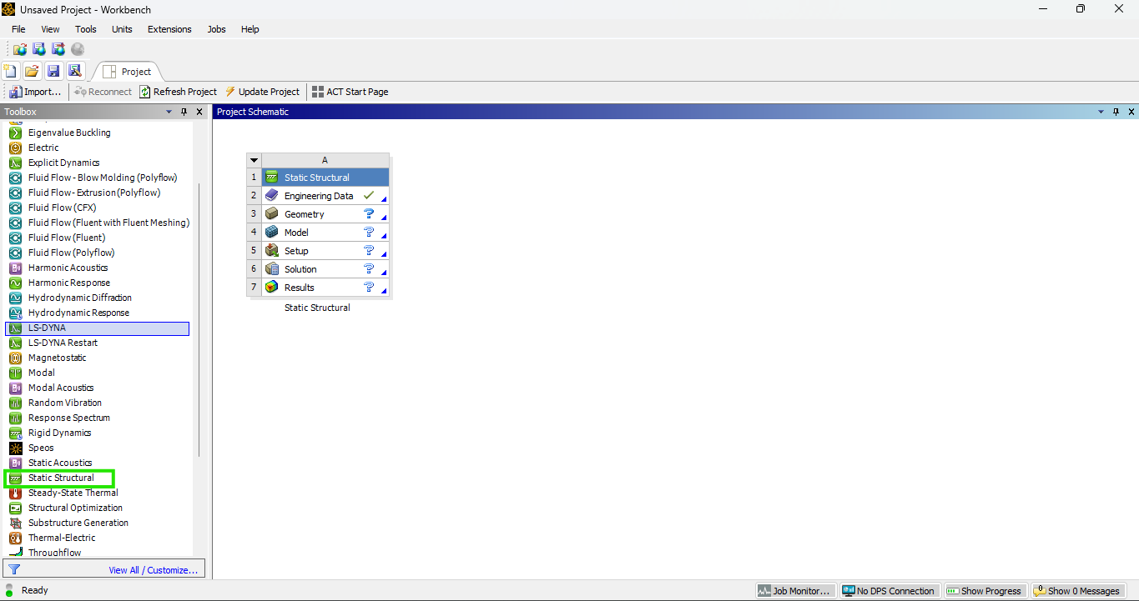
Open Workbench → New Project → Drag Static Structural into Workspace

Slide 4
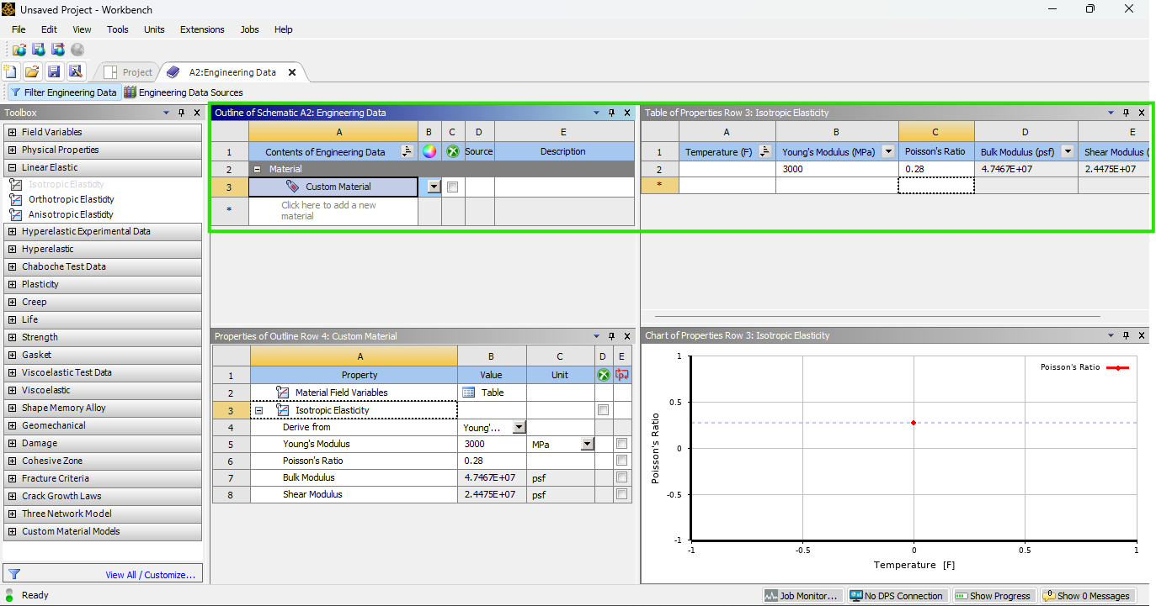
Add “Custom Material” in Engineering Data (E=3000 MPa, ν=0.28) → Delete Structural Steel

Slide 5
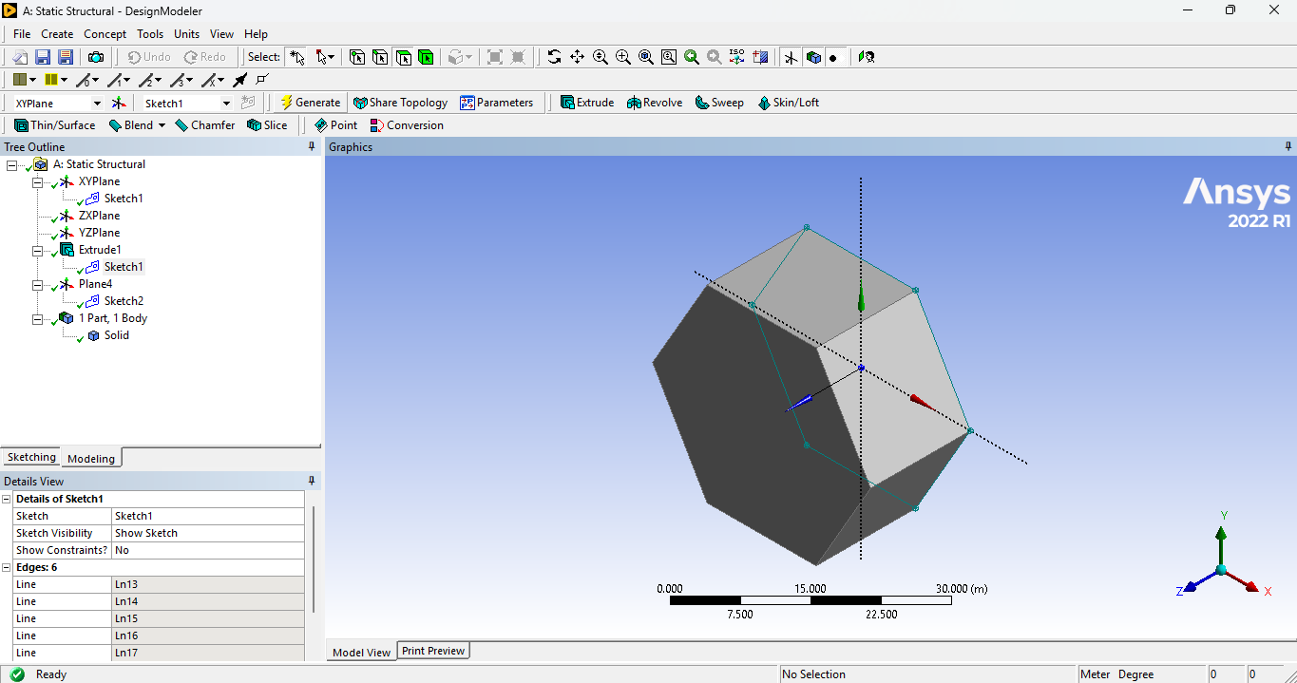
Open Design Modeler → Sketch Hexagon → Extrude → Set Length = 20 m

Slide 6
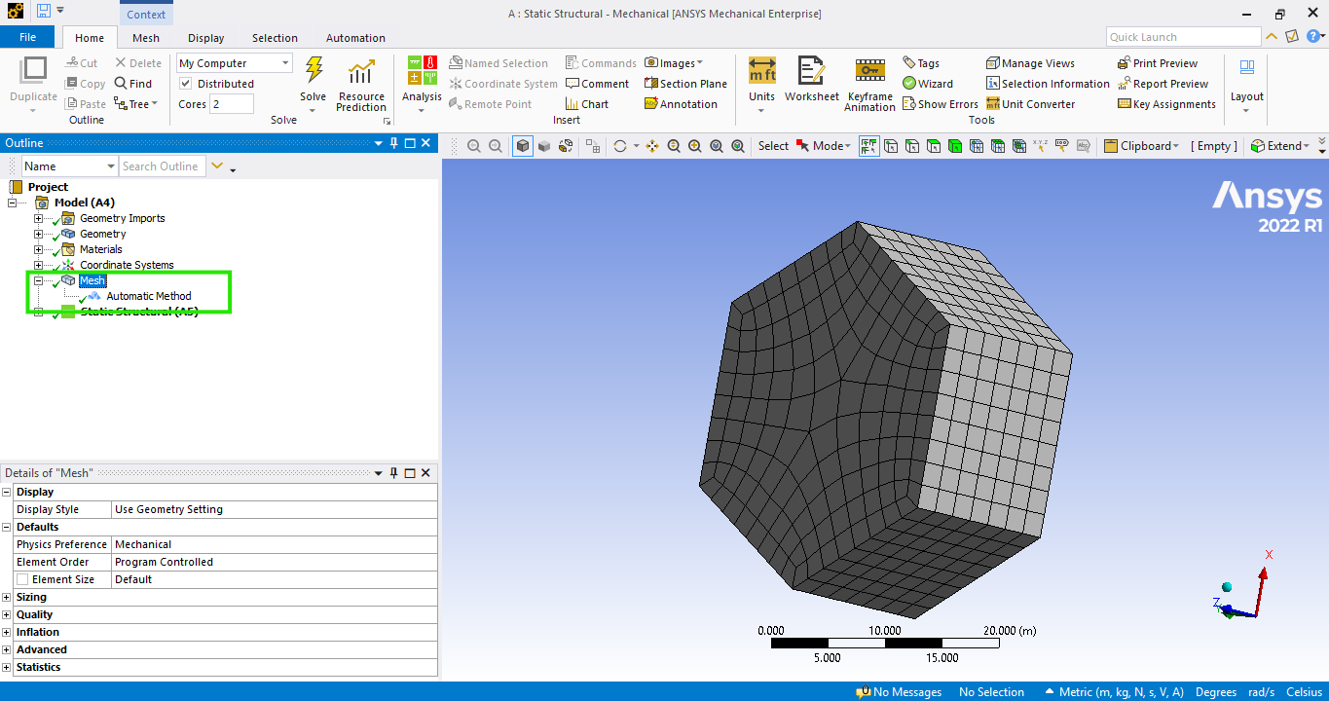
Open Mechanical → Generate Mesh → Set Sizing / Choose Mesh Type (tet or hex) if needed

Slide 7
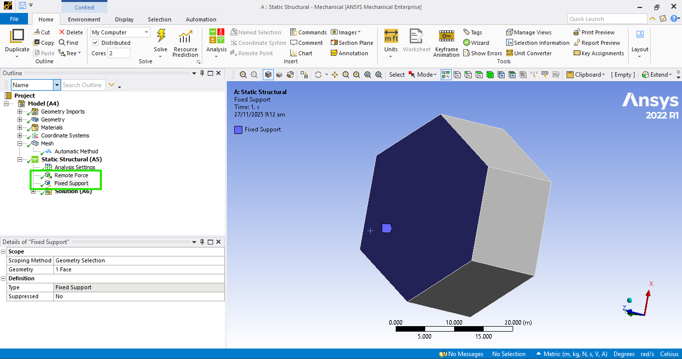
Apply Fixed Support at Bottom → Apply Remote Force at 1/3 Length of Hexagon

Slide 8
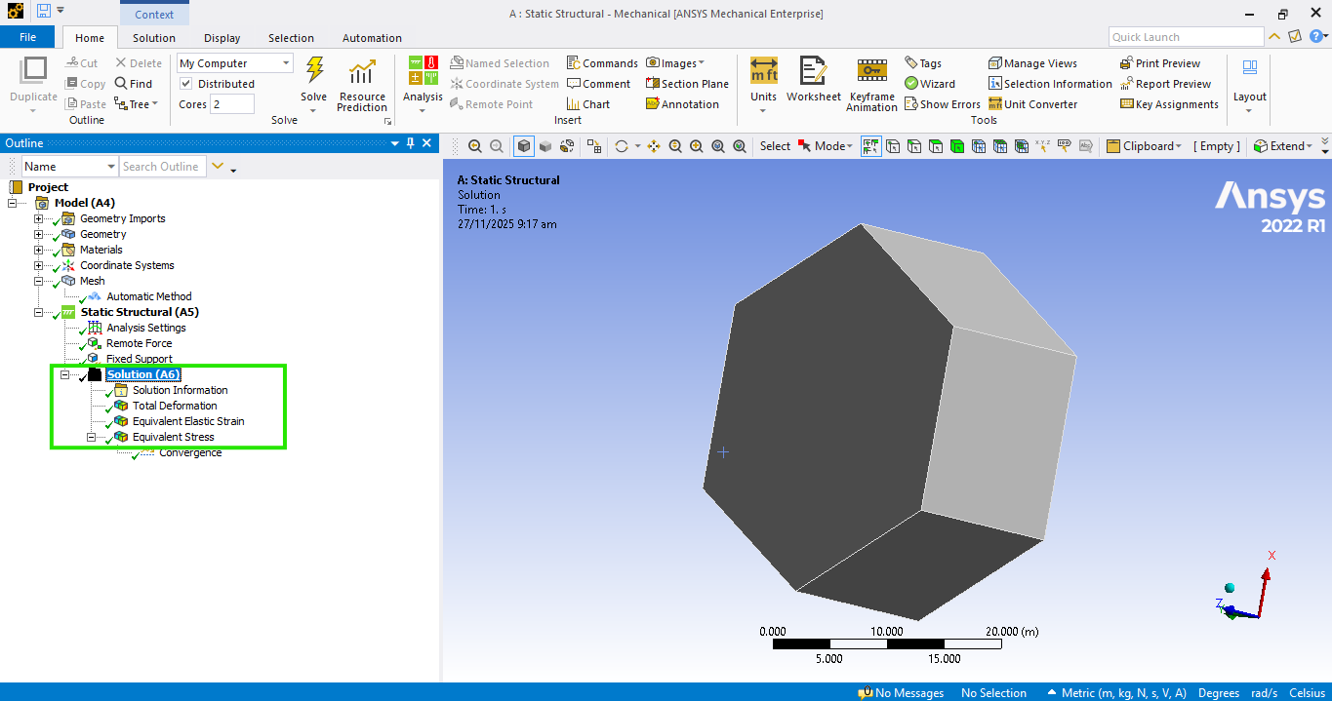
Select Total Deformation, Equivalent Stress & Strain → Solve to Compute Results

Slide 9
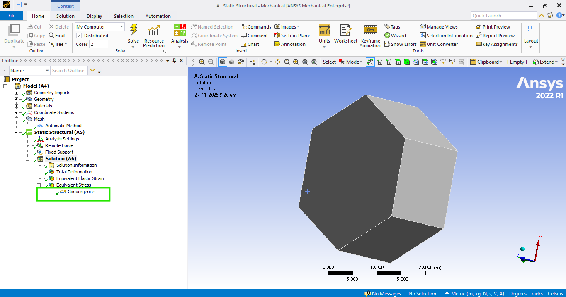
Right-click the Equivalent Stress result → Insert > Convergence.
Set Allowable Change to 15% and Max Refinement Loops to 3–4 so the solver won’t run endlessly.

Slide 10
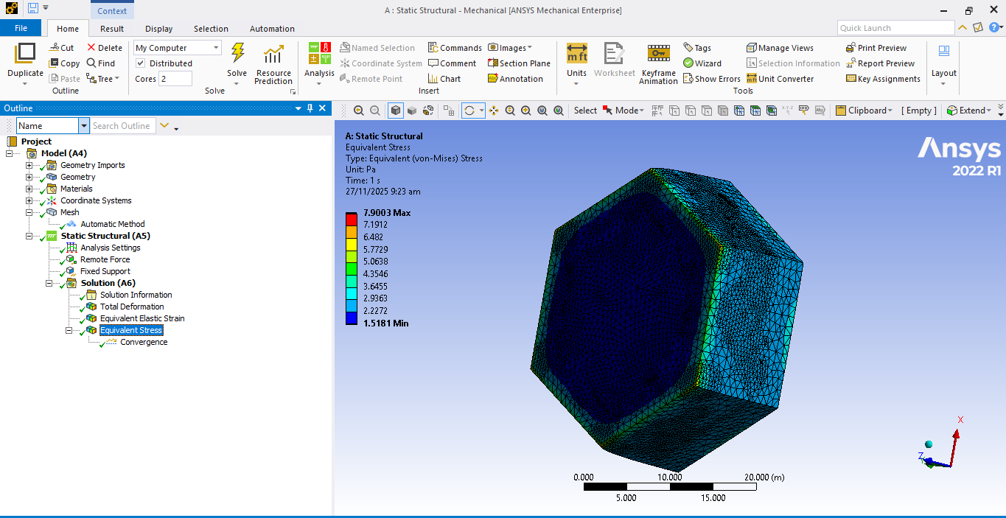
Solve Analysis → View Results & Convergence in Solution Section
Equivalent Stress

Slide 11
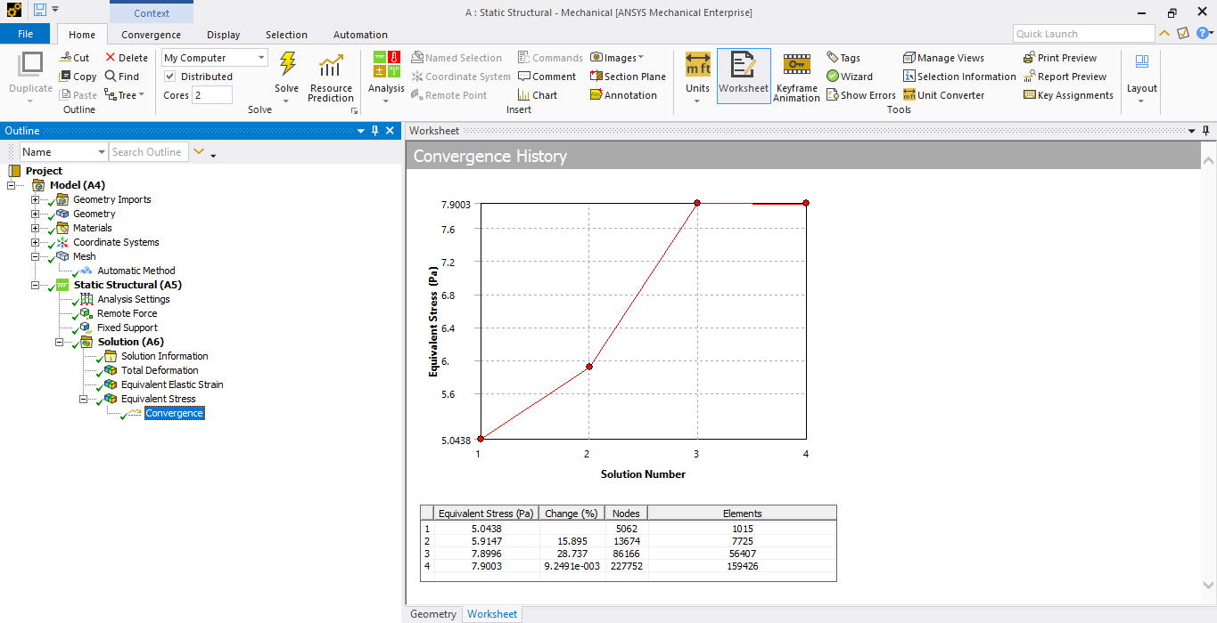
Convergence

Slide 12
THANK YOU

